Slide 1

Students Mental Health Assessments
Dimple Krishna Chintala
4221938

Slide 2
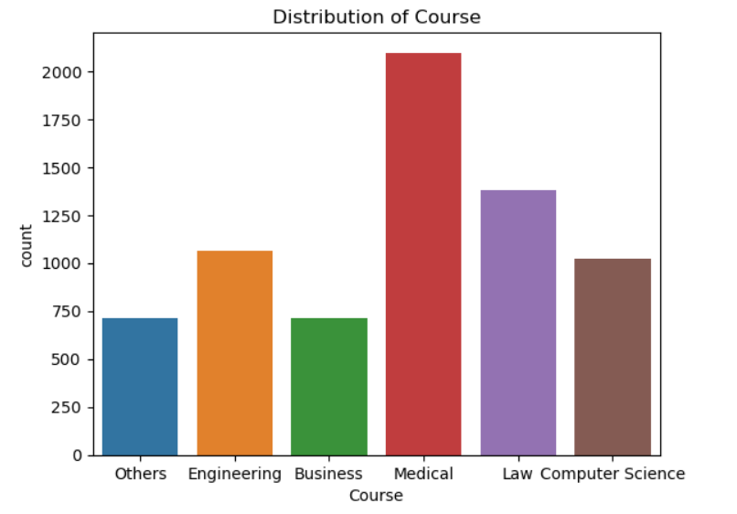
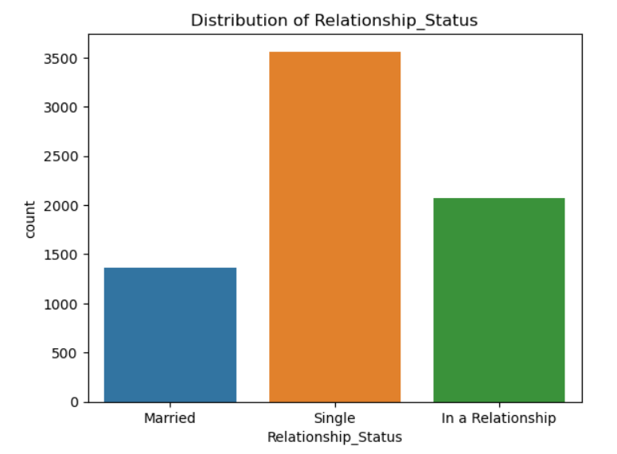
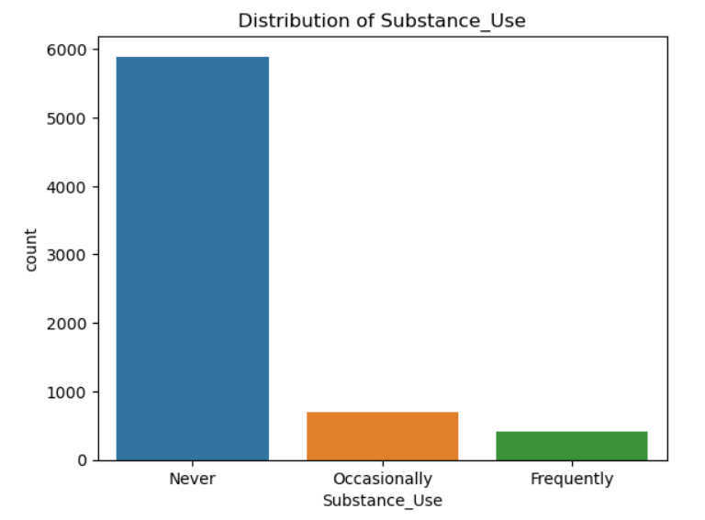
EDA based on the dataset
Course
Relationship_Status
Substance_Use

Slide 3
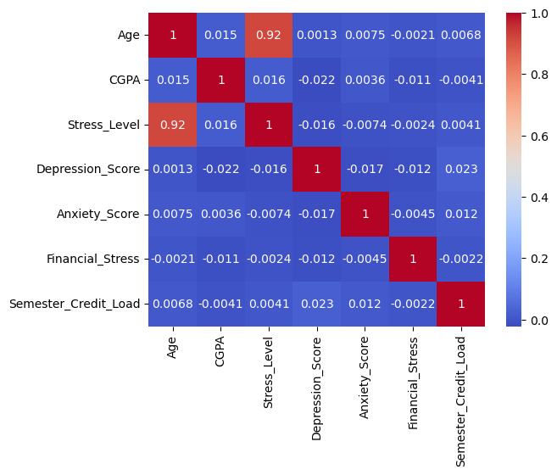
Correlation matrix
The correlation between stress_level and age is very high which is 92%

Slide 4
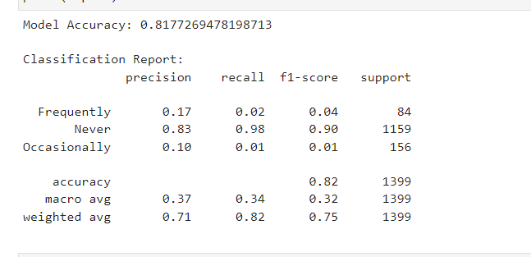
KNN Model
The K-Nearest Neighbors (KNN) model achieves an overall accuracy of about 81.77%. It performs well in predicting the 'Never' category but struggles with 'Frequently' and 'Occasionally'

Slide 5
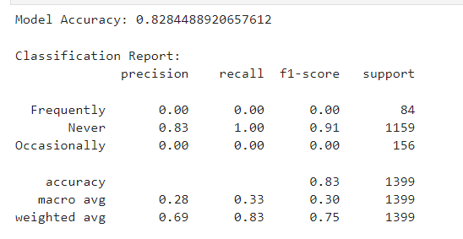
Logistic regression model
The logistic regression model achieved an overall accuracy of about 82.84%. It excels in predicting 'Never' instances perfectly but completely fails to predict 'Frequently' and 'Occasionally'

Slide 6


